Slide 1
Compiler Construction
Teacher : Zulfiqar Ali
Email: Zulfiqar.rafique@nu.edu.pk
Office: No.6,Basement -1 (CS Block 1)

Slide 2
Week 3:
Lexical Analyser Tools
Regex
Lex

Slide 3
Compiler Construction Tools
Jflap: JFLAP is software for experimenting with formal languages topics including nondeterministic finite automata, nondeterministic pushdown automata, multi-tape Turing machines, several types of grammars, parsing, and L-systems.
Regex: C++ offers a built-in regular expression library as part of its standard library, introduced in C++11. This library provides classes and functions for working with regular expressions, enabling tasks such as pattern matching, searching, and replacing within strings.
Flex & Bison: These are widely used tools for generating lexical analyzers and parsers, respectively, and are often employed in C/C++ compiler projects. (Lex for Lexical & Yacc for Parsing)
Jflex: JFlex is a lexical analyzer generator for Java. It takes a specification with regular expressions and actions to generate a program (lexer) that reads input and matches it against the expressions to generate a token stream.

Slide 4
Compiler Construction Tools
ANTLR (Another Tool for Language Recognition) with semantic predicates: is a powerful parser generator for reading, processing, executing, or translating structured text or binary files. Used for Syntax and Semantic Analysis
LLVM(Low Level Virtual Machine)The LLVM Core libraries provide a modern source- and target-independent optimizer, along with code generation support for many popular CPUs.
ANTLR: Another Tool for Language Recognition: Provides scanning, parsing and tree-walking functionalities, along with many others. It supports for Java.
JavaCC: Very popular parser generator Takes as input a language, converts it to a Java file, and then determines matches to this language. Builds syntax trees according to a given language using Java Tree Builder (JTB)

Slide 5
Jflap
JFLAP program makes it possible to create and simulate automata. Learning about automata with pen and paper can be difficult, time consuming and error-prone. With JFLAP we can create automata of different types and it is easy to change them as we want. JFLAP supports creation of DFA and NFA, Regular Expressions, PDA, Turing Machines, Grammars and more.

Slide 6
Jflap Setup
JFLAP is available from the homepage: (www.JFLAP.org). From there press “Get FLAP” and follow the instructions. You will notice that JFLAP have a .JAR extension. This means that you need Java to run JFLAP. With Java correctly installed you can simply select the program to run it. You can also use a command console run it from the file’s current directory with, Java –jar JFLAP.jar.

Slide 7
Using JFLap
When you first start JFLAP you will see a small menu with a selection of eleven different automata and rule sets. Choosing one of them will open the editor where you create chosen type of automata. Usually you can create automata containing states and transitions but there is also creation of Grammar and Regular Expression which is made with a text editor.

Slide 8
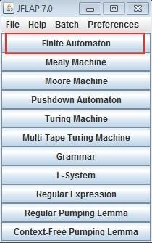
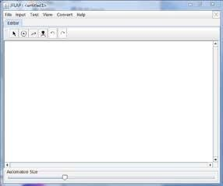

Finite Automata and Languages
The simplest type to begin with is Finite Automata, which is the first option from the selection menu. In JFLAP both DFA and NFA are created using Finite Automata.
Now you should have an empty window in front of you. You will have a couple of tools and features at your disposal.

Slide 9
Finite Automata and Languages
The toolbar contains six tools, which are used to edit automata.
Attribute Editor Tool, changes properties and position of existing states and transitions.
State Creator Tool, creates new states. Transition Creator Tool, creates transitions. Deletion Tool, deletes states and transitions.
Undo/Redo, changes the selected object prior to their history.
Creating an automaton is easy with the state and transition tools. Note that you need to change back to the Attribute Editor Tool (first) to change states. Let’s try to add states with the State Creator Tool (second).

Slide 10
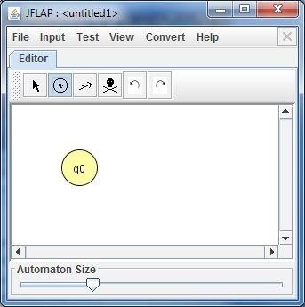
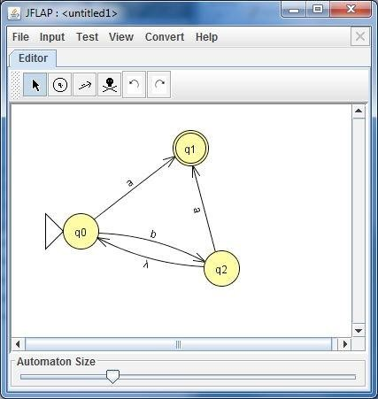

Slide 11
Attribute Editor Tool. Transitions are easily dragged between states with the Transition Creator Tool.
The automaton above only accepts strings containing b which end with a. To test this automaton you can use any of the available tools under the Input menu.
The fastest in this case is to use Input → Fast Run. A menu where you can set your input string pops up. Type the string “bba” and select “OK”. The program shows all the transitions that are done when consuming the input string.

Slide 12
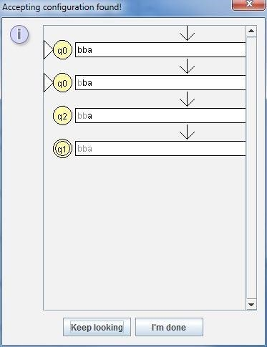
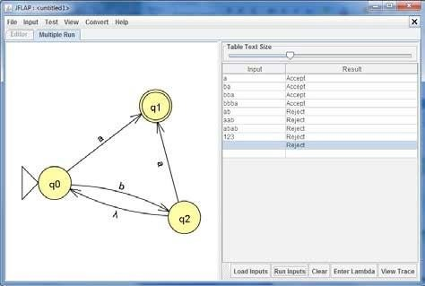
If you want to test multiple inputs at once you can select the “Multiple Run” option. If you wish to individually review single runs, it can be accessed by selecting the View “Trace”, which gives a view similar to the “Fast Run” option.

Slide 13
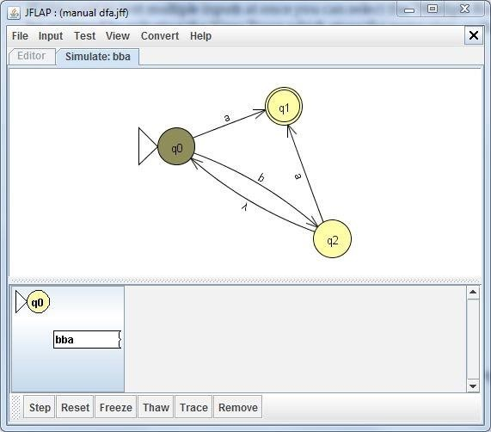
To debug the automata “Step by Closure” or “Step by State” can be selected. For each step the automaton highlights the currently active state.
For “stepping” you press the “Step” button.
The first character consumed. Notice that the first letter is grayed out and the currently active state have changed.

Slide 14
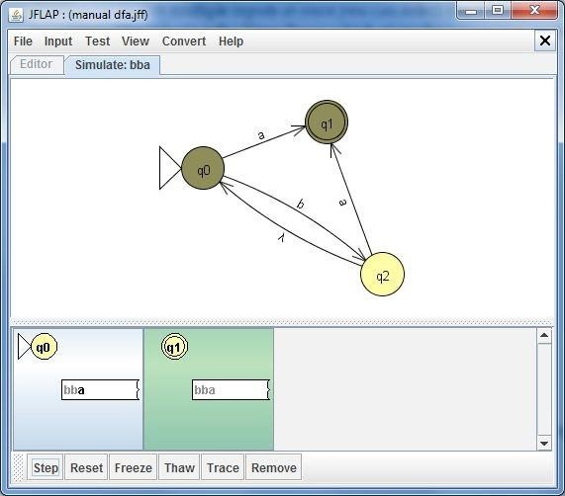
Now the last character is about to be consumed. This step shows the transition between q0 and q1. If there happen to be multiple paths with the same character you will see them grayed out.
The simulator reached the final state.

Slide 15
Regex
The regular expressions library provides a class that represents regular expressions, which are a kind of mini-language used to perform pattern matching within strings. Almost all operations with regexes can be characterized by operating on several of the following objects:
Target Sequence: The character sequence that is searched for a pattern. This may be a range specified by two iterators, a null terminated character string or a std::string.
Pattern: This is the regular expression itself. It determines what constitutes a match. It is an object of type std::basic_regex, constructed from a string with special syntax. See regex_constants::syntax_option_type for the description of supported syntax variations.

Slide 16
Matched Array: The information about matches may be retrieved as an object of type std::match_results.
Replacement String: This is a string that determines how to replace the matches, see regex_constants::match_flag_type for the description of supported syntax variations.
Main Classes: These classes encapsulate a regular expression and the results of matching a regular expression within a target sequence of characters.
basic_regex (C++11) | regular expression object (class template)
sub_match (C++11) | identifies the sequence of characters matched by a sub-expression (class template)
match_results (C++11) | identifies one regular expression match, including all sub-expression matches (class template)

Slide 17
Algorithms These functions are used to apply the regular expression encapsulated in a regex to a target sequence of characters.
Iterators The regex iterators are used to traverse the entire set of regular expression matches found within a sequence.
regex_match (C++11) | attempts to match a regular expression to an entire character sequence (function template)
regex_search (C++11) | attempts to match a regular expression to any part of a character sequence (function template)
regex_replace (C++11) | replaces occurrences of a regular expression with formatted replacement text (function template)
regex_iterator (C++11) | iterates through all regex matches within a character sequence (class template)
regex_token_iterator (C++11) | iterates through the specified sub-expressions within all regex matches in a given string or through unmatched substrings (class template)

Slide 18
Exceptions This class defines the type of objects thrown as exceptions to report errors from the regular expressions library.
Traits : The regex traits class is used to encapsulate the localizable aspects of a regex
Constants : Defined in namespace std::regex_constants
regex_error (C++11) | reports errors generated by the regular expressions library (class)
regex_traits (C++11) | provides meta information about a character type, required by the regex library (class template)
syntax_option_type (C++11) | general options controlling regex behavior (typedef)
match_flag_type (C++11) | options specific to matching (typedef)
error_type (C++11) | describes different types of matching errors (typedef)

Slide 19
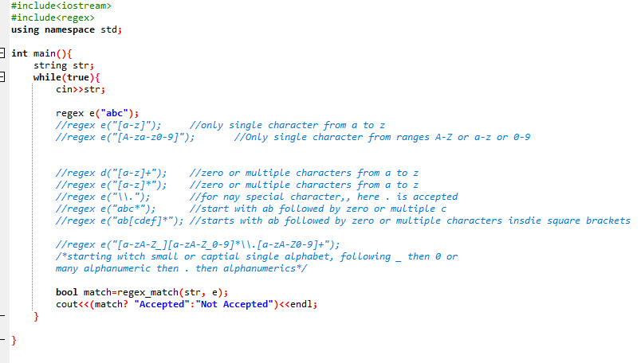
RegEx Examples
Program 1: Program to use regex() and regex_match() to match different patterns input by user.

Slide 20
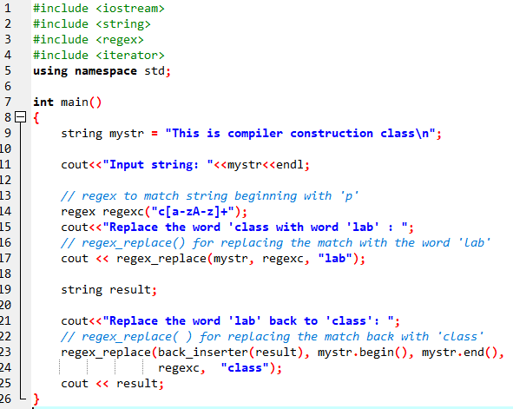
Program 2: Program to use regex_replace() for finding and replacing a word.

Slide 21
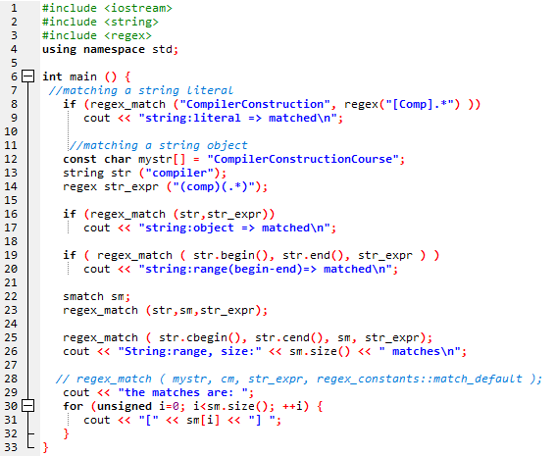
Program 3: Program to use regex_match() to match words

Slide 22
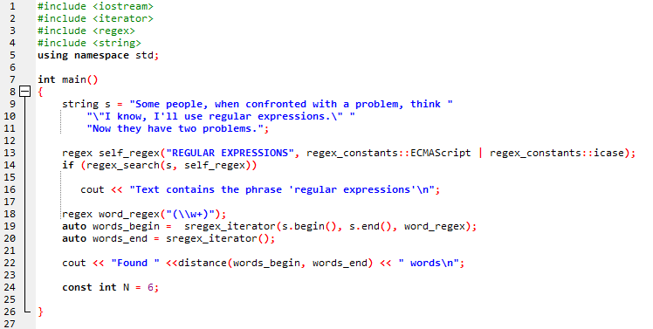
Program 4: Program to use regex_search() to search a word with in a sentence

Slide 23
Reference:
Compilers: Principles, Techniques, and Tools 2nd Edition by Alfred Aho , Jeffrey Ullman, Ravi Sethi, Monica Lam
Introduction to Compilers and Language Design | Second Edition | Prof. Douglas Thain - University of Notre Dame

